Slide 1
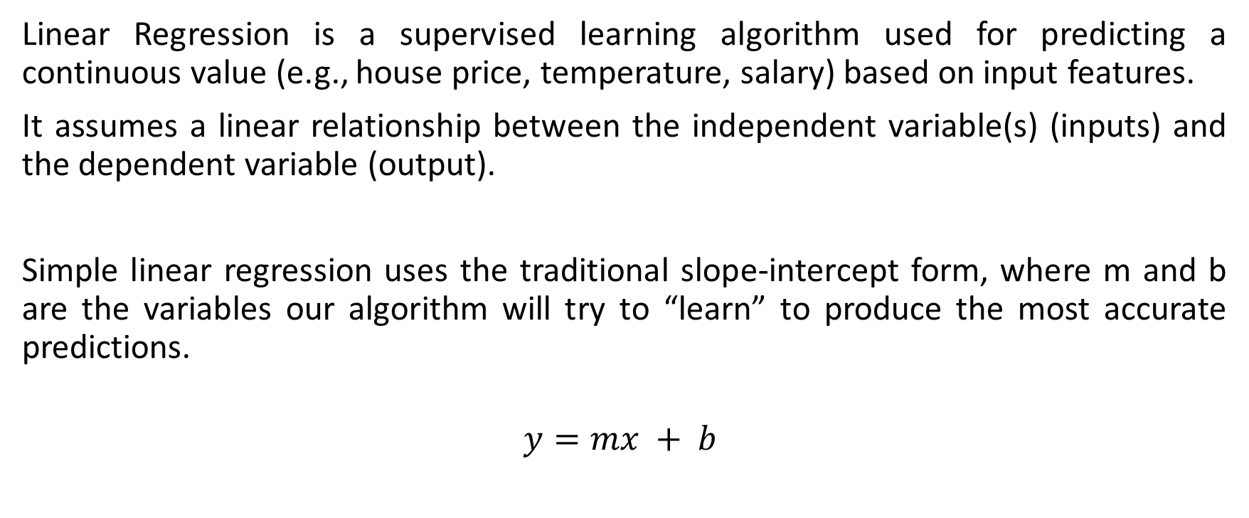
Linear Regression
Linear Regression is a supervised learning algorithm used for predicting a continuous value (e.g., house price, temperature, salary) based on input features.
It assumes a linear relationship between the independent variable(s) (inputs) and the dependent variable (output).
Simple linear regression uses the traditional slope-intercept form, where m and b are the variables our algorithm will try to “learn” to produce the most accurate predictions.
$$y=mx + b$$

Slide 2
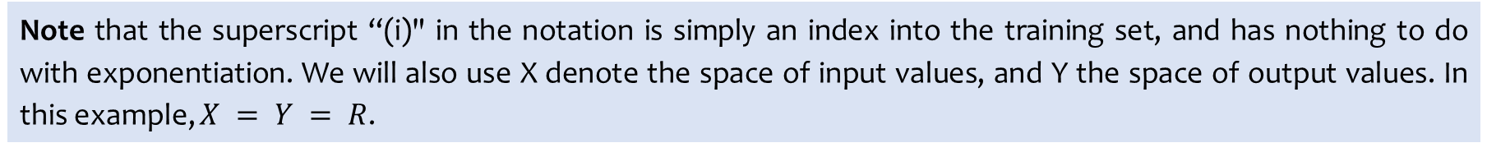
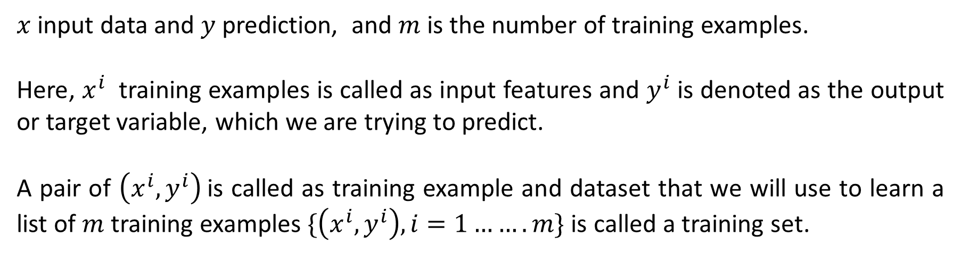
$x$ input data and $y$ prediction, and $m$ is the number of training examples.
Here, $x^{i}$ training examples is called as input features and $y^{i}$ is denoted as the output or target variable, which we are trying to predict.
A pair of $\left(x^{i}, y^{i}\right)$is called as training example and dataset that we will use to learn a list of $m$ training examples $\{\left(x^{i}, y^{i}\right), i=1…….m\}$ is called a training set.
Note that the superscript “(i)" in the notation is simply an index into the training set, and has nothing to do with exponentiation. We will also use X denote the space of input values, and Y the space of output values. In this example, $X = Y = R$.

Slide 3
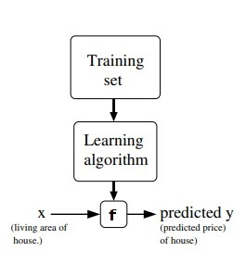
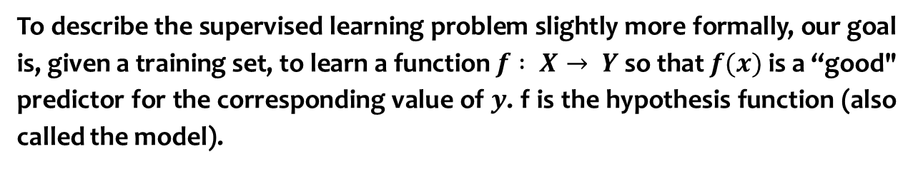
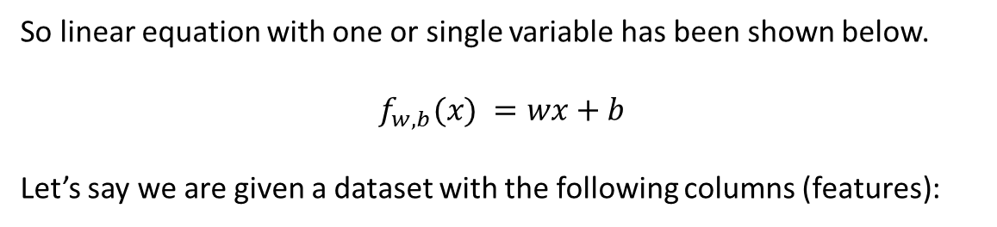
To describe the supervised learning problem slightly more formally, our goal is, given a training set, to learn a function $f : X→ Y$ so that $f(x)$ is a “good" predictor for the corresponding value of $y$. f is the hypothesis function (also called the model).
So linear equation with one or single variable has been shown below.
$$f_{w,b}(x) =wx+b$$
Let’s say we are given a dataset with the following columns (features):
Company | Radio ($) (x) | Sales (y)
Amazon | 37.8 | 22.1
Google | 39.3 | 10.4
Facebook | 45.9 | 18.3
Apple | 41.3 | 18.5

Slide 4
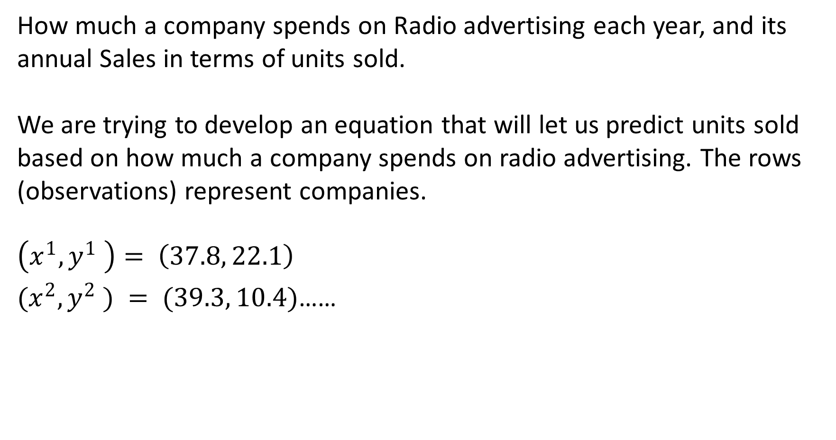
How much a company spends on Radio advertising each year, and its annual Sales in terms of units sold.
We are trying to develop an equation that will let us predict units sold based on how much a company spends on radio advertising. The rows (observations) represent companies.
$$\left(x^{1}, y^{1} \right)= \left(37.8, 22.1\right)$$
$(x^{2}, y^{2} ) = (39.3, 10.4)$……

Slide 5
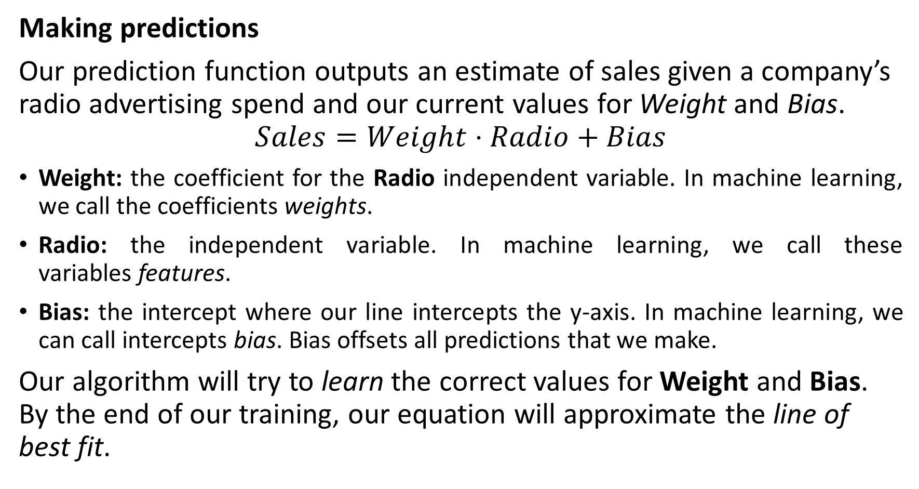
Making predictions
Our prediction function outputs an estimate of sales given a company’s radio advertising spend and our current values for Weight and Bias.
$$Sales=Weight⋅Radio+Bias$$
Weight: the coefficient for the Radio independent variable. In machine learning, we call the coefficients weights.
Radio: the independent variable. In machine learning, we call these variables features.
Bias: the intercept where our line intercepts the y-axis. In machine learning, we can call intercepts bias. Bias offsets all predictions that we make.
Our algorithm will try to learn the correct values for Weight and Bias. By the end of our training, our equation will approximate the line of best fit.

Slide 6
Intercept b (or bias)
• Predicted value when X=0
• May or may not have real meaning depending on context

Slide 7
Slope w (or weight)
• Change in Y for each unit change in X
• Positive slope → upward trend
• Negative slope → downward trend

Slide 8
Example: Study Hours → Exam Score
• Score = 40 + 5 × Hours
• Intercept = 40 → baseline score with 0 hours
• Slope = 5 → each hour adds 5 marks

Slide 9
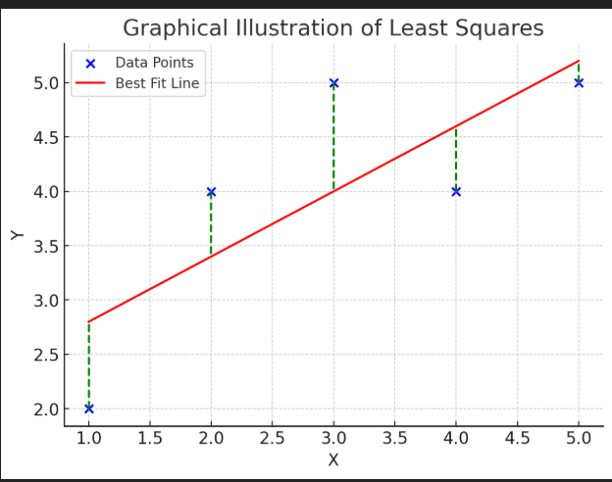
Graphical Illustration

Slide 10
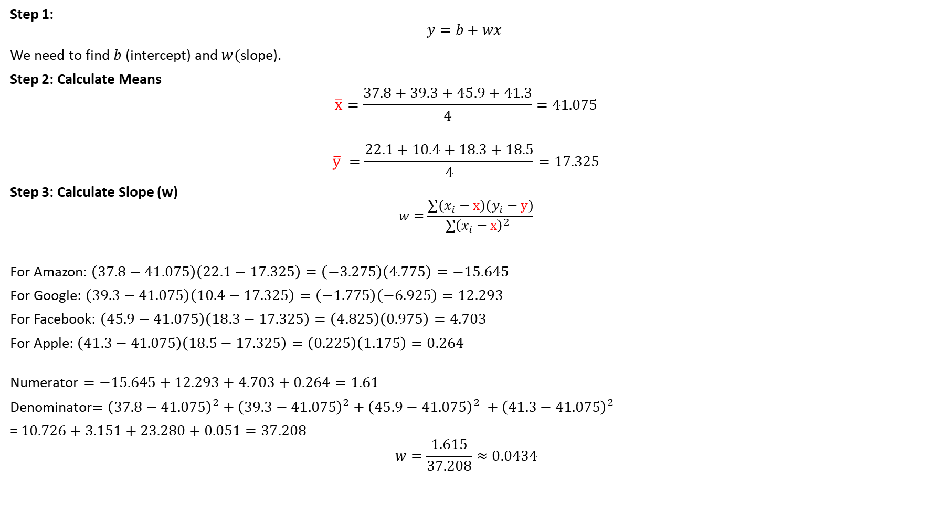
Step 1:
$$y=b​+w​x$$
We need to find$b$ (intercept) and $w($slope).
Step 2: Calculate Means
$$\overline{x}=\frac{37.8+39.3+45.9+41.3}{4}=41.075$$
$$\overline{y} =\frac{22.1+10.4+18.3+18.5}{4}=17.325$$
Step 3: Calculate Slope (w)
$$w​=\frac{∑(x_{i}​−\overline{x})(y_{i}​−\overline{y}​)}{∑{\left(x_{i}​−\overline{x}\right)}^{2}​ }$$
For Amazon: $\left(37.8−41.075\right)\left(22.1−17.325\right)=\left(−3.275\right)\left(4.775\right)=−15.645$
For Google: $\left(39.3−41.075\right)\left(10.4−17.325\right)=\left(−1.775\right)\left(−6.925\right)=12.293$
For Facebook: $\left(45.9−41.075\right)\left(18.3−17.325\right)=\left(4.825\right)\left(0.975\right)=4.703$
For Apple: $\left(41.3−41.075\right)\left(18.5−17.325\right)=\left(0.225\right)\left(1.175\right)=0.264$
$$\text{Numerator}=−15.645+12.293+4.703+0.264=1.61$$
Denominator$={\left(37.8−41.075\right)}^{2}+{\left(39.3−41.075\right)}^{2}+{\left(45.9−41.075\right)}^{2} +{\left(41.3−41.075\right)}^{2}$
= $10.726+3.151+23.280+0.051=37.208$
$$w=\frac{1.615}{37.208}≈0.0434$$

Slide 11
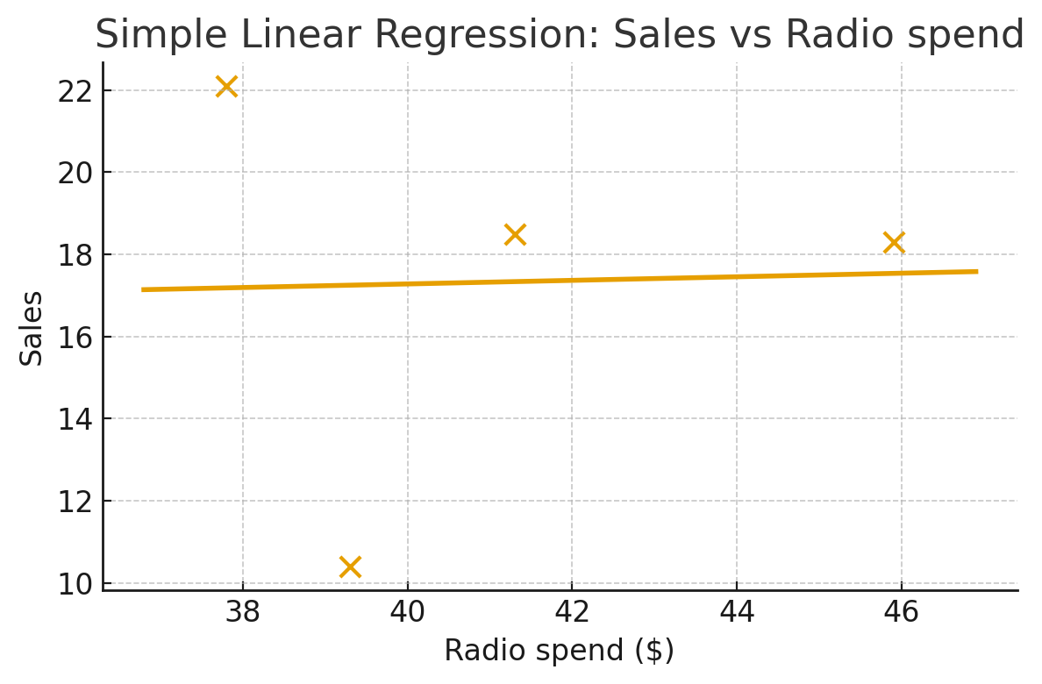


Step 4: Calculate Intercept b
$b=\overline{y}−w\overline{x}$
$$b=17.325−\left(0.0434\right)\left(41.075\right)≈15.54$$
Final Regression Equation: $\hat{y}=w.x+b$
$$\hat{y}=15.54+0.0434x$$
Step 5: Prediction Example
If a company spends $50 on radio ads:
$$\hat{y}=15.54+0.0434\left(50\right)≈17.71$$
So, predicted sales ≈ 17.7 units.
Company | Radio ($) | Actual Sales | Predicted Sales
Amazon | 37.8 | 22.1 | 17.182
Google | 39.3 | 10.4 | 17.248
Facebook | 45.9 | 18.3 | 17.535
Apple | 41.3 | 18.5 | 17.335
MSE = $\frac{1}{n}$ $\sum_{i=1}^{n}{\text{​}}{\left( y_{i} − \hat{y_{i}} \right)}^{2}$

Slide 12
x_i and y_i (for all i) -> Training dataset
y_hat = w . x_i+ b
Random values of w and b
w= 0.2 and b = .4 → w = 1 and b =.1
x_i = 4 and y_i = 5 ( training dataset)
y_hat = 0.2*4+0.4 = 1.2
Error = 1/n [sum over n (y_hat - y_i)^2] = 3.8

Slide 13

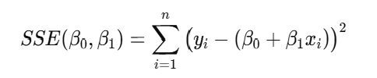
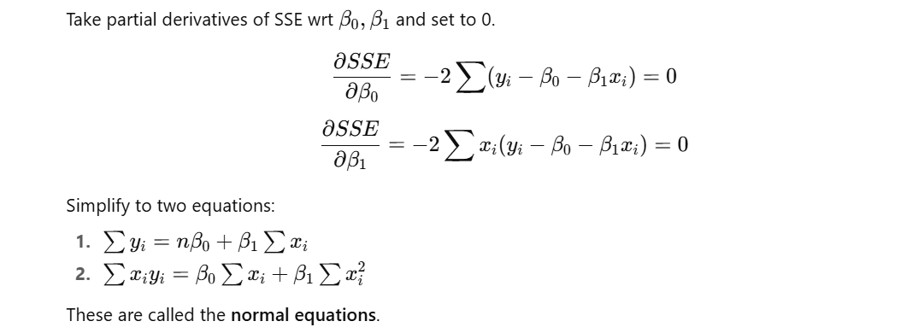
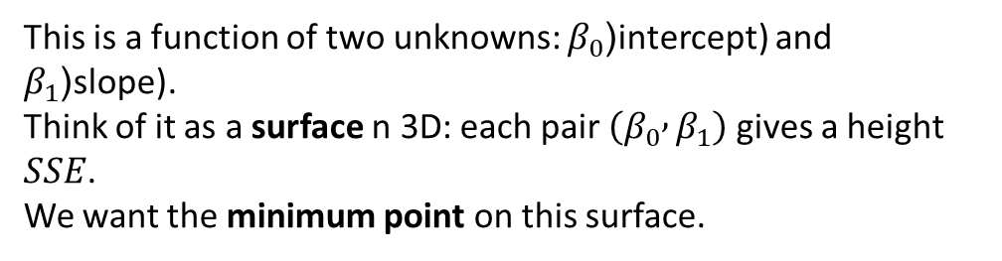
This is a function of two unknowns: $β_{0}$(intercept) and $β_{1}$(slope). Think of it as a surface n 3D: each pair $\left(β_{0} , β_{1}\right)$ gives a height $SSE$.
We want the minimum point on this surface.
A minimum occurs when the surface stops going downhill in any direction. Mathematically, this means the slope of the function wrt each variable is zero.

Slide 14
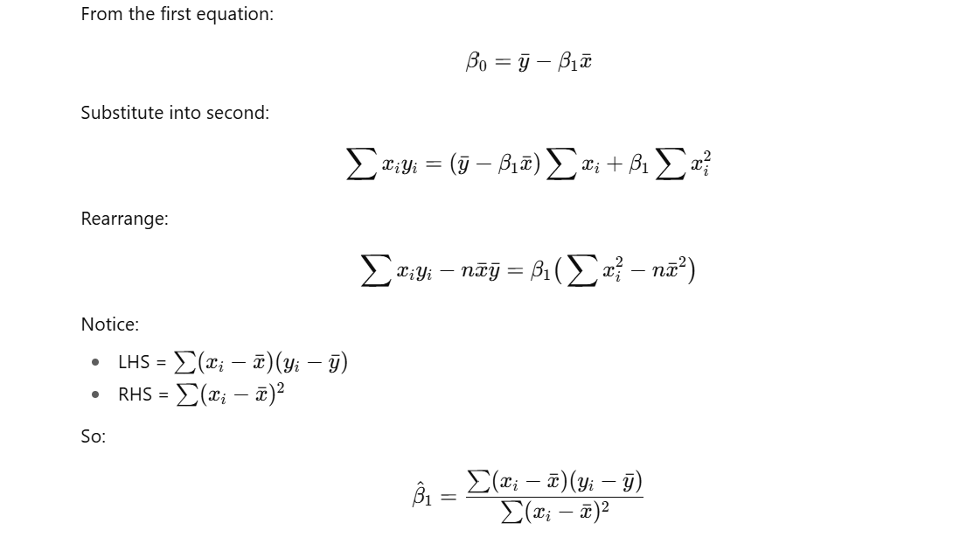
Numerator = covariance between x and y.
Denominator = variance of x. slope = Cov(x,y)/Var(x).

Slide 15
Assumptions in Linear Regression
Independence
errors are independent and identically distributed
Observations come from distinct experimental units
Linearity
Increasing x by 1 will have a fixed change in y
Normality
Residuals are normally distributed
Constant Variance
Variance is constant along the regression line

Slide 16
Linearity
Assumption: The relationship between X (predictor) and Y (target) is linear.
Check: A scatter plot of fitted values vs actual values should show a straight trend.
If it looks curved → linear regression is not appropriate, you may need polynomial regression.

Slide 17
Residuals
Assumption: Residuals (errors = actual – predicted) should be randomly scattered.
Check: In a residuals vs fitted plot, the points should not show a pattern (like a curve or systematic shape).
If there’s a clear pattern → the model is missing something (nonlinearity, omitted variable).

Slide 18
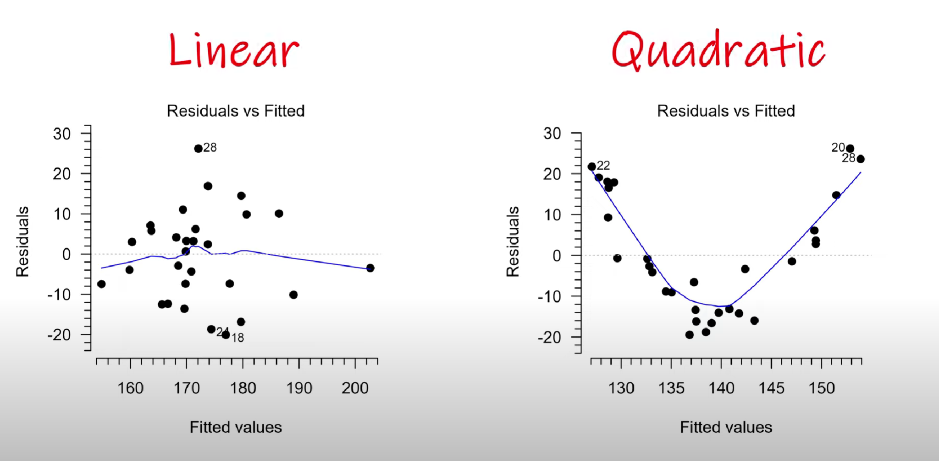
Analyzing Residual Plots

Slide 19
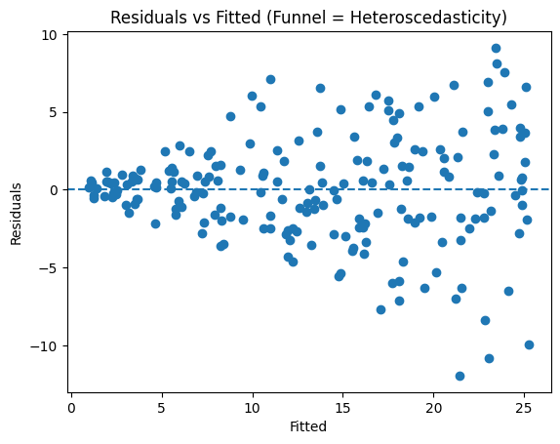
Homoscedasticity
Assumption: The variance of residuals is constant across all fitted values.
Check: Residual plot should look like a cloud of points with equal spread.
If residuals fan out (funnel shape) → heteroscedasticity problem (errors depend on X).
This affects the reliability of standard errors and confidence intervals.

Slide 20
Normality of Errors
Assumption: Residuals are normally distributed (bell-shaped).
Check: Plot a histogram or a Q-Q plot of residuals.
If residuals are not normal (very skewed or heavy-tailed), hypothesis tests & confidence intervals may be invalid.

Slide 21
Q–Q Plot
A Q–Q (quantile–quantile) plot compares the quantiles of your data (typically residuals from a regression) to the quantiles of a reference distribution (most often the Normal).

Slide 22
Analysis points
1) Right-skewed (positive skew / right-tailed)
Right tail (far right): points above the line (sample quantiles larger than Normal).
Left tail (far left): points below the line (often less extreme than Normal).
Asymmetry: the upper tail deviates much more than the lower tail.
2) Left-skewed (negative skew / left-tailed)
Left tail: points above the line.
Right tail: points below the line.
Asymmetry: the lower tail deviates more.
3) Heavy tails (symmetric, e.g., t-like / leptokurtic)
Both tails are more extreme than Normal:
Left tail below, right tail above the line, in a fairly symmetric S-shape.
The middle may lie close to the line.
4) Light tails (symmetric, e.g., uniform-ish / platykurtic)
Both tails are less extreme than Normal:
Left tail above, right tail below the line (reverse S), roughly symmetric.

Slide 23
Why this matters
If all these checks are satisfied: The regression model is valid and reliable.
If not → predictions may be biased or misleading, and you might need transformations (log, polynomial) or a different model.

